Slide 1
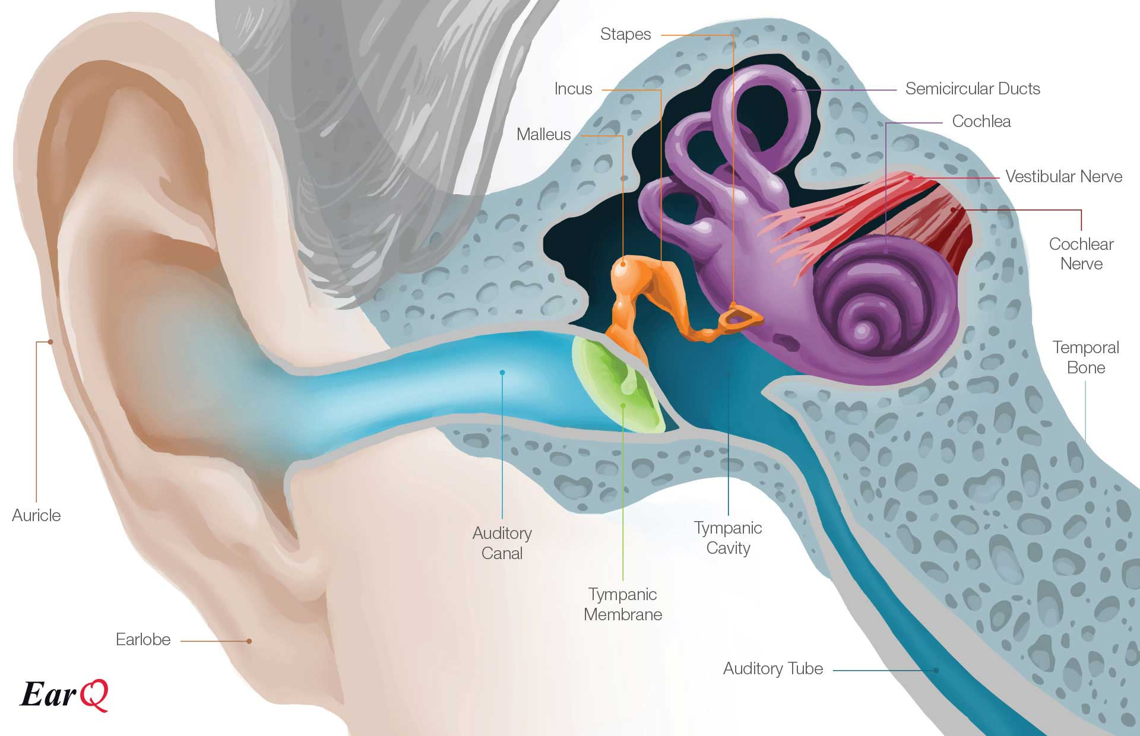
Daily Review
CFU 1
List the three parts of the outer ear.
Outer Ear – where sound waves are collected
Ear flaps (auricle)
collects sound waves and directs them into the ear canal
Ear (auditory) canal
carries sound waves 2-3cm to the eardrum
Eardrum
thin membrane separating outer ear from middle ear
Vibrates when struck by a sound wave in order to transmit sound to the middle ear
CFU 2
Describe the role of the ear drum in hearing.
Vocabulary
Auditory: relating to the sense of hearing.

Slide 2
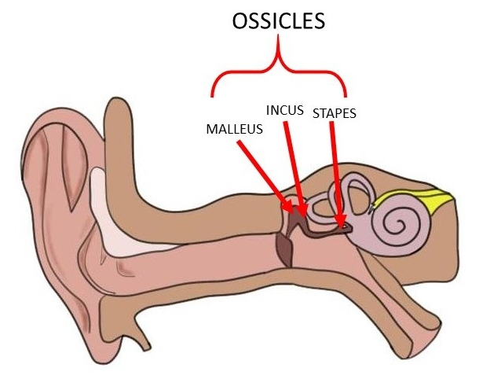
Daily Review
CFU 1
Describe the function of the middle ear.
Middle ear– where sound is amplified
Ossicles
Three loosely connected bones of the middle ear
Smallest bones of the human body
Vibrations are passed to the ossicles from the ear drum
Vibrations are transmitted through ossicles to the cochlea via a thin membrane called the oval window
CFU 2
Describe the path sound takes to travels from the auricle to the oval window.
Note
Eustachian Tube: ensures air pressure in the middle ear is the same as outside the ear.

Slide 3
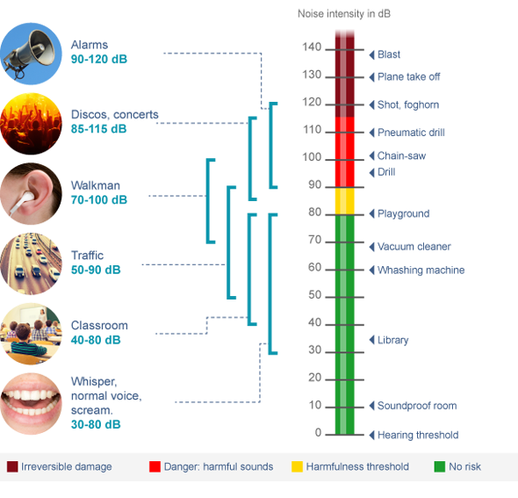
Daily Review
Sound level
A measure of the intensity of sound that we hear.
Measured in decibels (dB)
Named after Alexander Graham Bell, the inventor of the telephone.
As the sound level increases by 10, it gets 10 times more intense.
CFU 1
If the sound level increases from 30 dB to 40 dB, what is the increase in intensity?
CFU 2
If the sound level increases from 30 dB to 50 dB, what is the increase in intensity?

Slide 4
Wave Interference Year 9 Physics

Slide 5
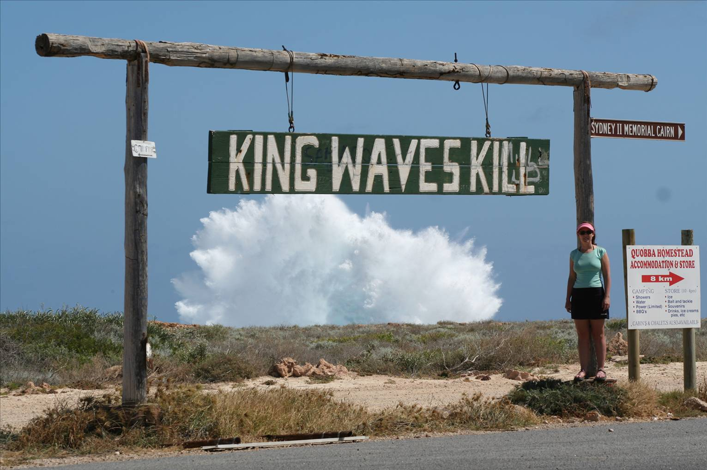
Learning Objectives
CFU
What will we be learning today?
Describe the behaviour of waves as they interact.
Identify real life applications of wave interactions.
Activate Prior Knowledge
This video shows a King wave.
Describe your observations of the waves before the King wave, compared to the king wave itself.
How might this happen?
https://www.youtube.com/watch?v=UdH85JPUg6Q (mute the sound!)

Slide 6
Concept Development
CFU 1
Name the two types of wave interaction.
Interactions Between Waves
As waves cross one another, they are capable of interfering with each other in two different ways.
Constructive interference
Destructive interference
We call this wave interaction the superposition of waves.
CFU 2
What does superposition mean?
Note
Superposition: The combined effect of two or more waves on a medium.

Slide 7
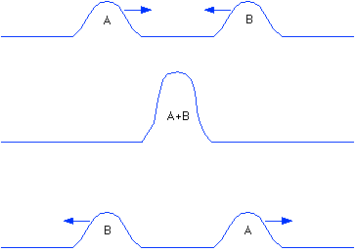
Concept Development
CFU 1
Describe how constructive interference occurs.
Constructive Interference
As two wave fronts pass each other the waves interact to create a wave with a larger amplitude.
If two areas of compression meet, you get an area of larger compression.
CFU 1
Think-pair-share: Can you think of a real life experience that might involve constructive interference?
Note
Amplitude: the distance from the mid point of a wave to its peak/trough.

Slide 8
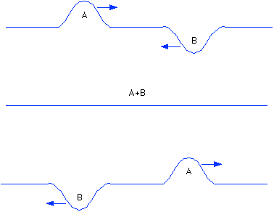
Concept Development
CFU 1
Describe how destructive interference occurs.
Destructive Interference
As two wave fronts pass each other the waves interact to create a wave with a smaller amplitude.
If an area of compression meets an area of rarefaction, they cancel each other out.
CFU 1
Think-pair-share: Can you think of a real life experience that might involve destructive interference?
Note
Amplitude: the distance from the mid point of a wave to its peak/trough.

Slide 9
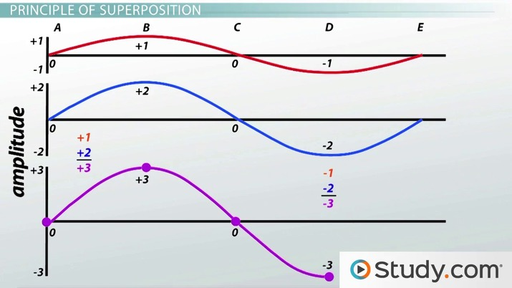
Skill Development/Guided Practice
Identifying Interference
Are the two waves interfering to make a wave of a larger amplitude? = Constructive Are the 2 waves interacting to make a wave of a smaller amplitude? = Destructive
Looking at waves below, are they interacting to cause constructive or destructive interference? Justify your answer.
The waves are interacting to create a wave of a larger amplitude, therefore this is constructive interference.
Reminders:
Amplitude: the distance from the mid point of a wave to its peak/trough.

Slide 10
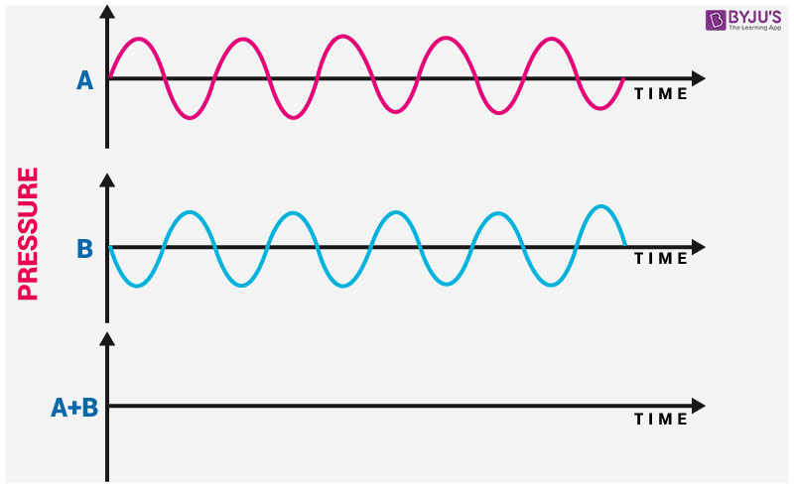
Skill Development/Guided Practice
Identifying Interference
Are the two waves interfering to make a wave of a larger amplitude? = Constructive Are the 2 waves interacting to make a wave of a smaller amplitude? = Destructive
Looking at waves below, are they interacting to cause constructive or destructive interference? Justify your answer.
The waves are interacting to create a wave of a _________ _______, therefore this is _________ interference.
Reminders:
Amplitude: the distance from the mid point of a wave to its peak/trough.

Slide 11
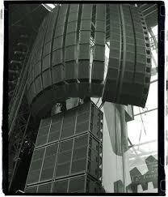
Skill Development/Guided Practice
Identifying Interference
Are the two waves interfering to make a wave of a larger amplitude? = Constructive Are the 2 waves interacting to make a wave of a smaller amplitude? = Destructive
Miss Lagrange is at a concert and she decides to walk to the bathroom, on her way she notice that the sound gets louder at one point, what type of interference is causing this?
The waves are interacting to create a wave of a _________ _______, therefore this is _________ interference.
Reminders:
Amplitude: the distance from the mid point of a wave to its peak/trough.

Slide 12

Skill Development/Guided Practice
Identifying Interference
Are the two waves interfering to make a wave of a larger amplitude? = Constructive Are the 2 waves interacting to make a wave of a smaller amplitude? = Destructive
Noise cancelling headphones act to cancel out constant background noise such as a plane engine. Which type of interference is occurring within the headphones to cancel out the background noise? Justify your choice.
The waves are interacting to create a wave of a _________ _______, therefore this is _________ interference.
Reminders:
Amplitude: the distance from the mid point of a wave to its peak/trough.

Slide 13
Relevance
Many every day events involving waves are a result of waves interacting.
Constructive interference can cause dangerous king waves at beaches.
Destructive interference is used in noise cancelling headphones and can cause sound ‘dead spots’ at large concert venues.
Understanding the ways in which waves interact can help you to understand these events and even keep you safe.

Slide 14
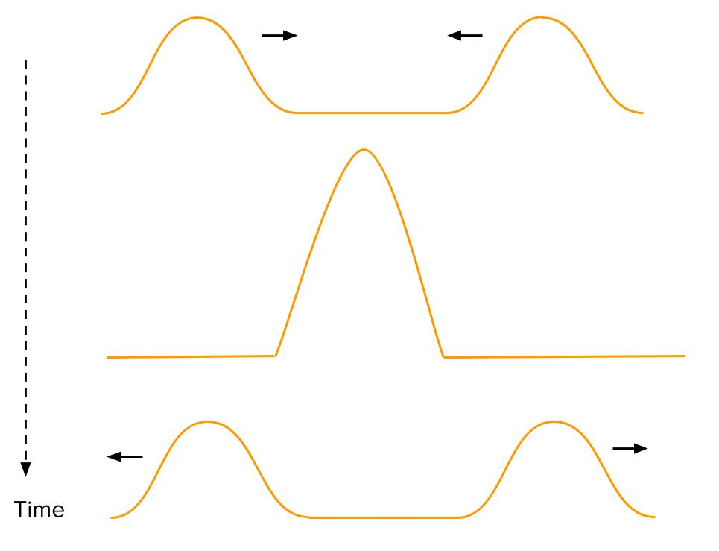
Skill Closure
If two waves interact to make a wave of smaller amplitude, what type of interference is occurring?
Identifying Interference
Are the two waves interfering to make a wave of a larger amplitude? = Constructive Are the two waves interacting to make a wave of a smaller amplitude? = Destructive
Skill Closure
Thinking back to the king wave at the start of the video, describe which type of interference was occurring to form the king wave.
Skill Closure
Is the wave to the right an example of constructive or destructive interference? Justify your answer.

Slide 15
Independent Practice
Make a list of 15 keywords involving Sound.
Write clues/questions for these words, and either create a crossword or word search for another student to complete.

